Slide 1
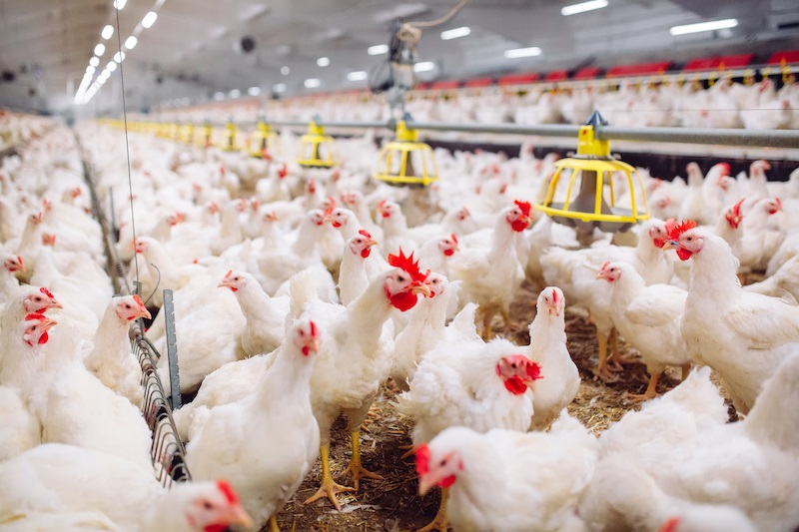
Optimizing Global Live Chickens Import Market Strategies Using Machine Learning Models: An Analytical Approach for Predicting Import Quantities (heads) and Values (US$)
DSC680-T301 Applied Data Science (2251-1)
Term Project 1: Final Presentation
Author: Zemelak Goraga
Date: 9/21/2024
Instructor: Prof. Amirfarrokh Iranitalab

Slide 2
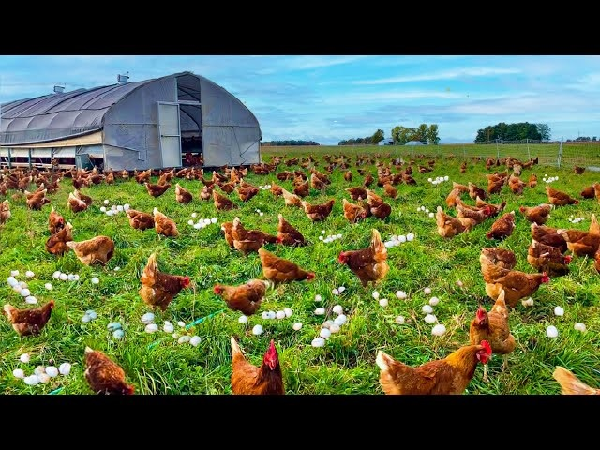
Introduction
Global trade in live chickens is crucial for food security and economic stability
Traditional forecasting methods struggle with market complexities
Machine learning provides more accurate predictions and actionable insights
Fills gaps in understanding global poultry market dynamics

Slide 3
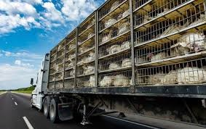
Scope of the Project
Used FAOSTAT data from 1998 to 2013
Covered import quantities and values across 200+ countries
Machine learning models used: Random Forest, Support Vector Regression, Gradient Boosting
Objective: Provide practical, data-driven recommendations for market strategies

Slide 4
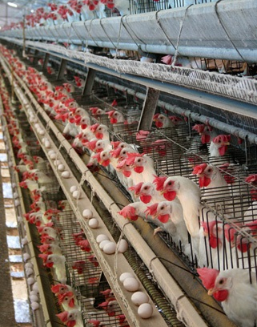
Business Problem
Global live chickens import market is complex and volatile
Challenges: fluctuating demand, economic conditions, changing trade policies
Inaccurate forecasts lead to inefficiencies, financial losses
Machine learning can provide reliable forecasts to optimize strategies and mitigate risks

Slide 5
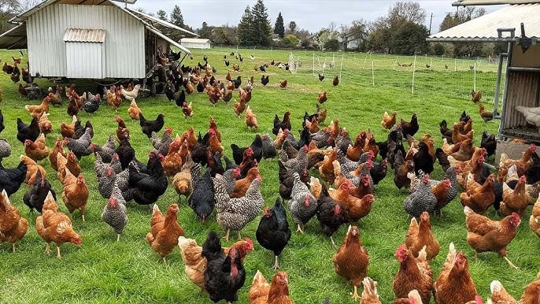
Research Questions
Trend Analysis: What are the historical trends in the global import quantities and values of Chickens from 1998 to 2013?
Country Comparison: Which countries were the top importers of Chickens from 1998 to 2013?
Correlation Analysis: What is the correlation between import quantities and values Chickens globally?
Predictive Modeling: Which predictive models provide the most accurate forecasts for future import quantities and values of Chickens, and what are the key predictors influencing these imports?
Optimization and Sustainability Strategies: What strategies can be recommended to enhance trade agreements, stabilize prices during economic volatility, and improve productivity and import capacity through sustainable Poultry farming practices and efficient agricultural techniques?

Slide 6
About the Dataset
I used the FAOSTAT dataset (1961-2013), covering over 200 countries.
It includes data on import quantities and values of Chickens, providing a comprehensive view of global trade trends.
Data allowed for a deep analysis of trade patterns and trends for extracting valuable insights for improving trade strategies

Slide 7
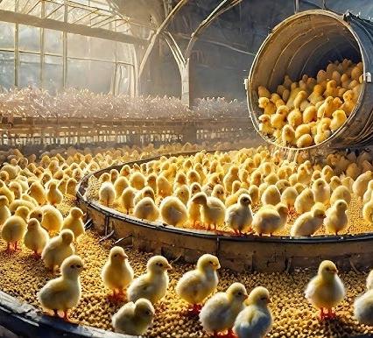
Methodology
My methodology involved data importation, cleaning, feature engineering, and exploratory data analysis.
I tested models like Random Forest, Support Vector Regression, Gradient Boosting models
Hyperparameter tuning to optimize model performance

Slide 8
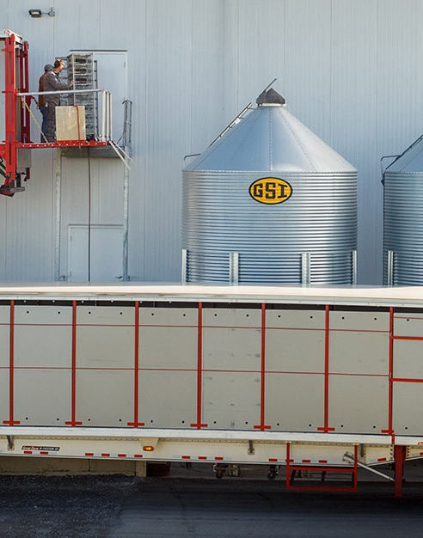
Assumptions
FAOSTAT dataset is accurate and representative of market trends
Market behavior remains consistent over time
Machine learning models are suitable for analyzing global trade data

Slide 9
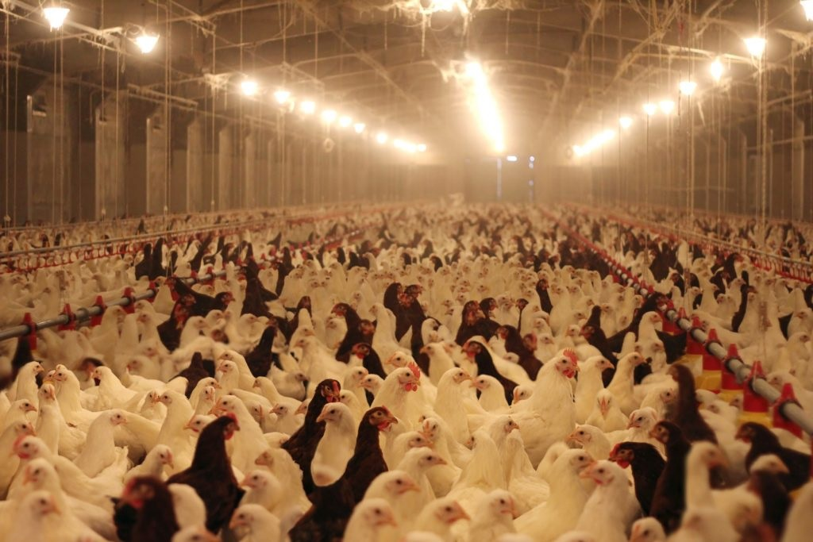
Ethical Concerns
Ensured data was handled responsibly and privacy was maintained
Avoided biases, especially for small-scale farmers
Considered broader implications of findings for all market participants
Focus on sustainability and fairness in global trade

Slide 10
Results - Descriptive Analysis
Analyzed data from 1998 to 2013 across multiple countries
Average annual import quantity (top 10 countries): 228,724 heads (1999) to 509,844 heads (2012)
Import values ranged from $246,488 (2000) to $841,934 (2013)
Positive correlation (0.97) between import quantities and values

Slide 11
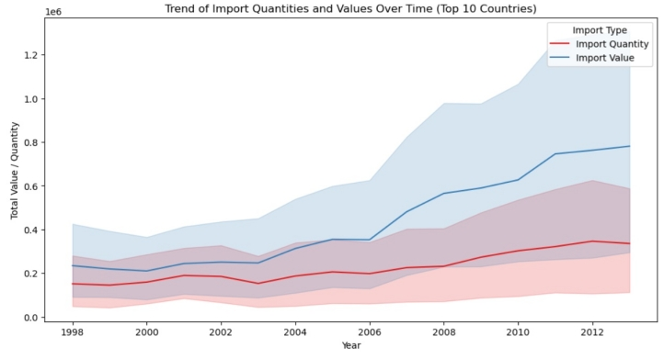
Trend Analysis: Chickens import Quantity and Value
Time series analysis showed steady growth in import quantities and values (1998-2013)

Slide 12
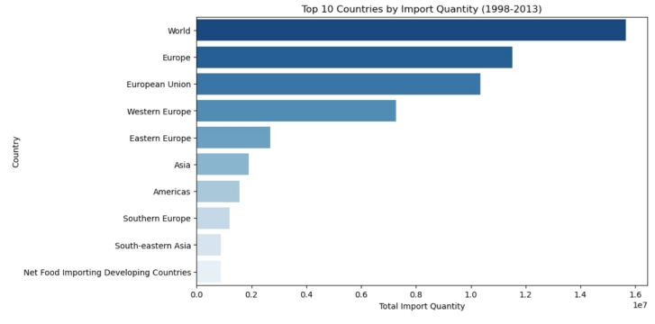
Country Comparison: Import Quantity (heads)
Europe and the European Union emerging as the largest importers in terms of quantity, accounting for 11,519,025 heads and 10,349,759 heads, respectively

Slide 13
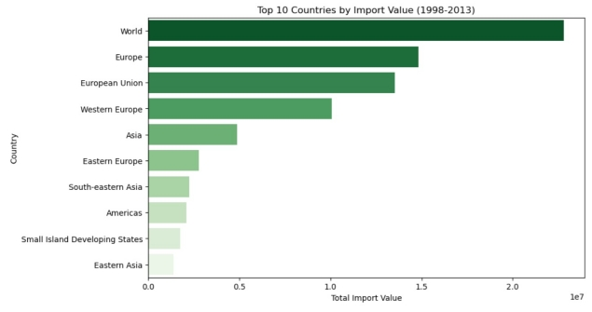
Country Comparison: Import Value (US$)
Similarly, Europe leads in import value with a total of $14,824,884, followed by the European Union with $13,543,745.

Slide 14
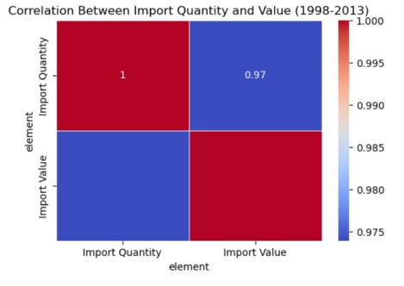
Correlation between import quantities and values:
The correlation was 0.97, indicates a strong positive relationship.
This suggests that as the volume of imports increases, the associated costs rise proportionally

Slide 15
Predictive Modeling
I tested various models:
Random Forest: R-squared = 0.97, Mean Squared Error = 21,183,281
Gradient Boosting: R-squared = 0.96, MSE = 28,155,650
Support Vector Regression underperformed but captured niche trends
Random Forest demonstrated superior performance for larger markets

Slide 16
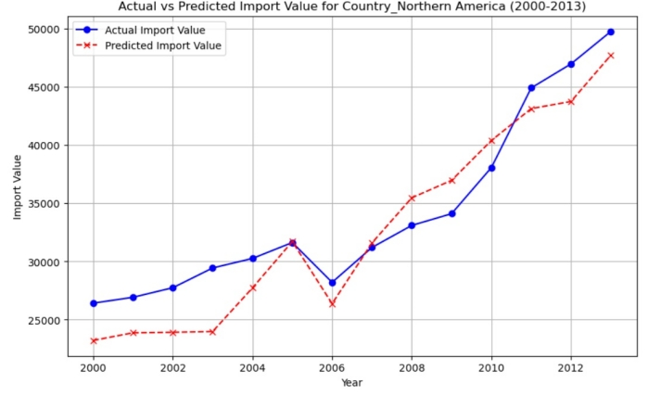
Actual Vs. Predicted Import Values
Random Forest accurately predicted import values
Example: 2013 actual import value: $49,780; predicted: $47,738
Model captured market trends with high precision

Slide 17
Discussion
Analysis provided comprehensive understanding of factors driving import quantities/values
Machine learning models, especially Random Forest, proved highly effective
Insights gained can enhance trade strategy, risk management, and decision-making
Predictive models offer essential tools for navigating volatile market conditions

Slide 18
Conclusions
Machine learning successfully applied to predict global live chickens import quantities/values
Random Forest model provided most accurate results
Models help stakeholders make more informed, data-driven decisions
Predictive analytics can revolutionize market strategies and improve overall efficiency
Key insights with considerable impact

Slide 19
Recommendations
To optimize the Poultry import market, I recommend several strategic actions:
Adopt machine learning for market forecasting (e.g., Random Forest)
Focus on emerging markets to seize new opportunities
Improve data collection and integrate real-time economic indicators
Strengthen risk management and prioritize sustainability in trade practices

Slide 20
Future Applications
Extend machine learning methodologies to other agricultural sectors (cattle, dairy, crops)
Apply to real-time market monitoring, supply chain optimization, policy analysis
.
Machine learning models can drive innovation and efficiency in multiple sectors
Stakeholders can leverage these techniques to enhance global trade strategies

Slide 21
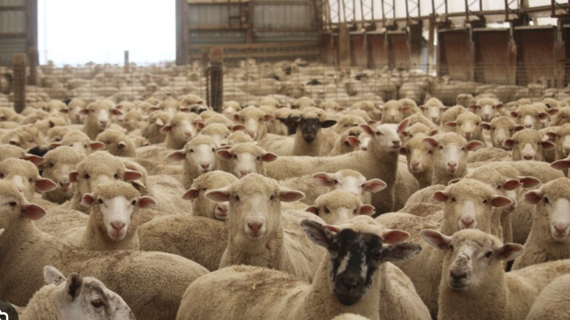
Reference
Food and Agriculture Organization of the United Nations (FAO). (n.d.). FAOSTAT data. http://www.fao.org/faostat/en/#data
Hsu, H. Y., & Lee, C. L. (2021). Predictive analytics in smart agriculture. Routledge. https://doi.org/10.4324/9780367424218
Hindawi. (2021). Broadening the research pathways in smart agriculture: Predictive analysis using semiautomatic information modeling. Hindawi. https://doi.org/10.1155/2021/5391823

Slide 22
Thank You!

